Slide 1

CLINICAL CYTOGENETICS
Lora W. Lucas
Lead Cytogenetic Technologist-Microarray
Cytogenetics Lab

Slide 2
CYTOGENETICS
Branch of genetics that focuses on the examination of chromosomes to identify structural changes that result in abnormalities that we are born with or that we acquire over time.
Birth defects
Developmental and/or intellectual delays/disabilities
Infertility
Recurrent miscarriages
Cancer
Notes:
Cytogenetics is a branch of genetics that focuses on the examination of chromosomes to identify structural changes that result in abnormalities that we are born with or that we acquire over time. Patients are often referred for cytogenetic analysis due to the following issues: birth defects, developmental and/or intellectual delays/disabilities ,infertility, recurrent miscarriages, and cancer. This is not an exhaustive list, but are some of the more common reasons for referral that we see in our lab.
The finding of a chromosomal abnormality can be critical for correct diagnosis and proper medical plan of action for the patient.

Slide 3
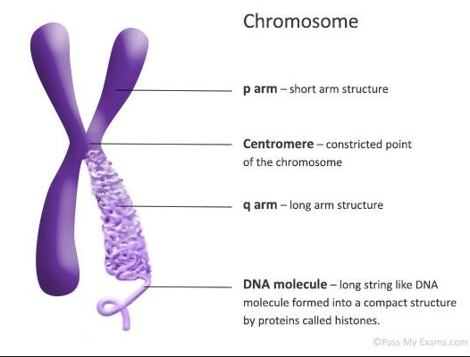
What is a chromosome?
Organized, thread-like, tightly packaged molecule of DNA found in the nucleus of the cell
Notes:
So, what is a chromosome? It is and organized, thread-like, tightly packaged molecule of DNA found in the nucleus of the cell and it looks roughly like this. It has a short arm which is referred to as the p arm, and a long arm which is referred to as the q arm. That pinched area you see in the middle on this chromosome is the centromere.

Slide 4
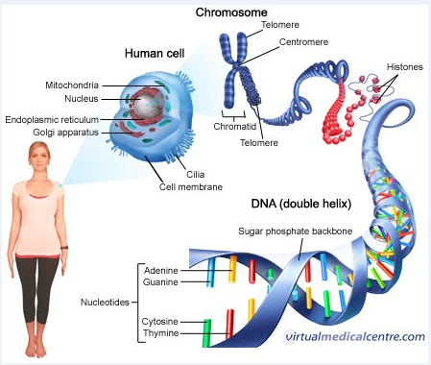
Chromosomes:
in the grand scheme of things
Notes:
Where does the chromosome fall in the grand scheme of things in the human body. Your body is made up of tissues, which are made up of cells. Each cell has a nucleus. The nucleus contains a complete set of chromosomes. Each chromosome is made up of one highly organized, highly compressed, molecule of DNA. Genes are made up of DNA in a particular sequence and of a particular size. There are many, many genes on one chromosome: 20K to 25K. With that in mind, lets focus on the chromosomes.

Slide 5
Before you can analyze for abnormalities, you have to know what NORMAL looks like…

Slide 6
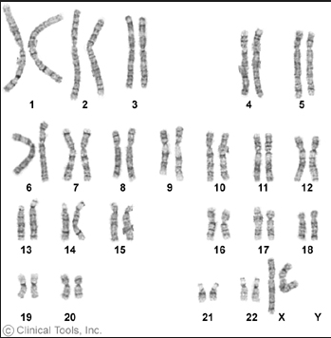
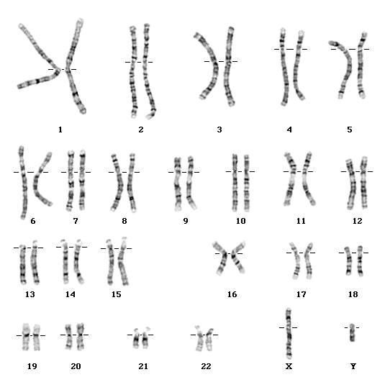
Normal Karyograms
G-banded chromosomes
Normal Female
46,XX
Normal Male
46,XY
Notes:
And here we have normal. On the left we have a normal female karyotype, on the right a normal male karyotype. Generally speaking, we as humans have 46 chromosomes. In females there are 23 pairs that are alike in banding patterns, including the sex chromosomes, with females having 2 copies of the X chromosome. In males, there are 22 pairs that are alike in banding patterns, however, the sex chromosomes for males are not identical, males having one X chromosome and one Y. These cells have been stained with Giemsa stain in order to visualize the unique banding pattern for each chromosome. X and Y chromosomes are called sex chromosomes, while the remaining 22 pairs are referred to as autosomes. As a cytogenetic technologist I have to commit to memory the normal banding patterns for each of these chromosomes in order to be able to recognize when a chromosome has lost material (deletion), gained material (duplication), or has a rearrangement that could be the cause of the disorder or disease that the patient is presenting. Now that we know what qualifies as normal, let’s take a look at the different types of chromosomal abnormalities.

Slide 7
What are we looking for? Copy number changes
Have we lost or gained any genetic material?
Whole genome
46, XY vs. 69,XXY
Whole chromosomes
Trisomy: +13,+18, +21
Monosomy: XO
Parts of chromosomes
Deletions (loss)
Duplications (gain)
Notes:
One of the first things that we look for is copy number change. Have we lost or gained any genetic material? There are different ways that copy number changes may present themselves. We may see an extra copy of the entire genome. We may see gain or loss of an entire chromosome. Or we might see even smaller gains or losses within a chromosome.

Slide 8
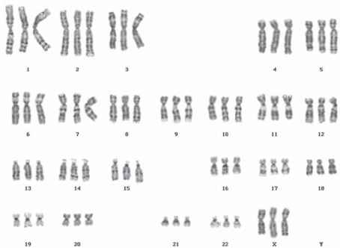
Copy Number Change Whole Genome
Whole genome-gain only
Incompatible with long term survival
A human fetus with triploidy often results in early miscarriage
46, XX - normal 69,XXX - triploidy
Notes:
First let’s start with the whole genome. In this instance you’re only going to see gains. Here we have 3 copies of every chromosome and we refer to this as triploidy. Generally speaking, this abnormality is incompatible with long term survival, and results in multiple often severe birth defects. Most often triploidy results in early miscarriage.

Slide 9
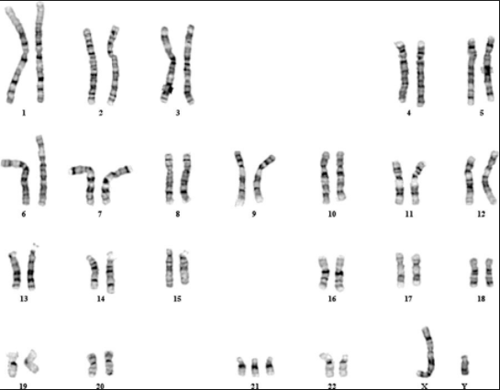
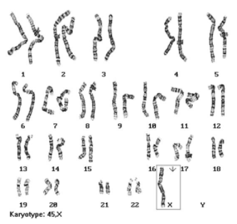
Copy Number Change Whole Chromosomes
Gain Loss
47,XY,+21 45,XO
Down Syndrome Turner Syndrome
Notes:
Here we see two examples of whole chromosome copy number change. On the left we have a gain of chromosome 21, which is also known as Down Syndrome. On the right we have a copy number loss of the sex chromosome, leaving us with one copy of the X chromosome. This is commonly known as Turner Syndrome.

Slide 10
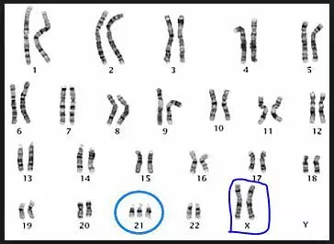
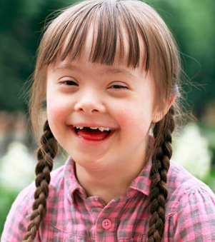
Copy Number Changes
Whole chromosome gain
47,XX,+21
Down Syndrome
-Characteristic facial features
-Anomalies affecting heart and gastrointestinal tract
-Increased risk of leukemia
-Immune systems defects
-Developmental delays/disabilities
Notes:
First we’ll talk about Down Syndrome. These individuals have characteristic facial features including: flattened profile and nose, small head, ears, and mouth, upward slanting eyes, often with a skin fold that comes out from the upper eyelid and covers the inner corner of the eye, as well as an oversized tongue. They also may have anomalies affecting the heart, lung, and GI tract, increased risk of developing leukemia, immune system defects, and often (but not always) exhibit developmental delays/disabilities.

Slide 11
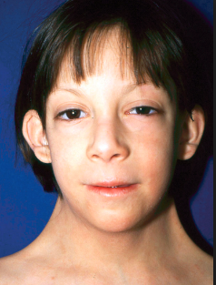
Copy Number Changes
Whole chromosome loss
45,X
Turner Syndrome
-Shorter than average height
-Low set ears
-Webbed neck (variable)
-Infertile due to non-functional ovaries
-Frequent ear infections (early childhood)
-May require hormone treatment to develop a more female physique.
-Cardiac and renal defects
Notes:
Here we have an example of whole chromosome copy number loss where we are missing a whole sex chromosome and are left with only one copy of X. This is also known as Turner Syndrome. These individuals of often have shorter that average height, low set ears, webbed neck, infertility due to non-functional or absent ovaries, frequent ear infections in childhood, cardiac and renal defects. These patients may require hormone treatment to develop a more female physique.

Slide 12
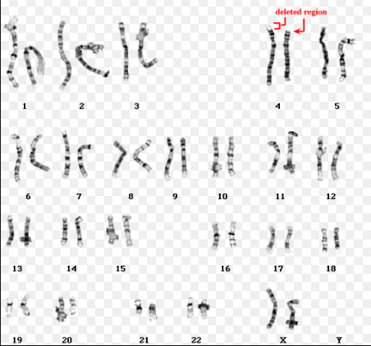
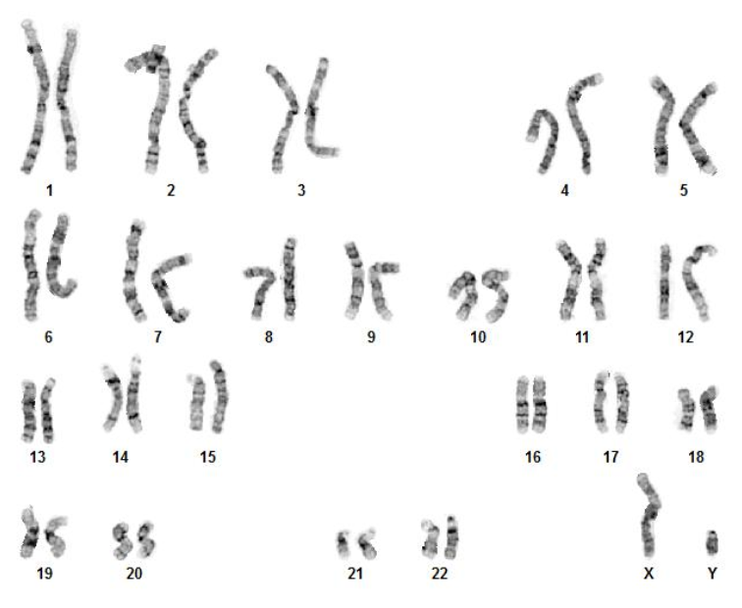
Copy Number Changes Within Chromosomes
Deletion 4p Duplication 15q
Wolf-Hirschhorn syndrome Sometimes assoc with ASD
Notes:
Here are some examples of copy number change within chromosomes. On the left is a karyogram of a patient with Wolf-Hirschhorn Syndrome which is associated with a deletion at the end of the p arm of chromosome 4. In the karyogram on the right, take a look at chromosome 15 which has a small duplication close to the centromere on its q arm. This abnormality sometimes is associated with autism spectrum disorders.

Slide 13
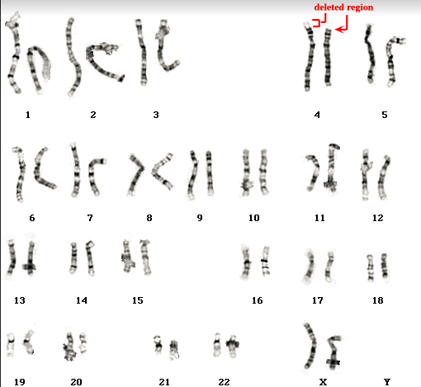
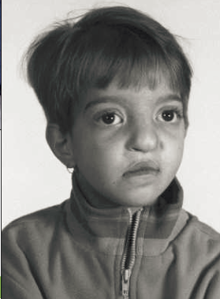
Copy Number Change Within Chromosomes
Deletions
Wolf-Hirschorn Syndrome, 4p-
-characteristic facial features
-delayed growth and development
-impaired verbal communication/language skills
-low muscle tone
-prone to seizures
-microcephaly
-short stature
-skeletal anomalies
Notes:
Wolf-Hirschorn Syndrome is characterized by a loss of genetic material at the end of the p arm of chromosome 4. Here you can see the typical facial characteristics. These patients often display delayed growth and development, impairment of verbal communication/language skills, low muscle tone, are prone to seizures, and may have microcephaly, short stature, and skeletal anomalies

Slide 14

Copy Number Change Within Chromosomes
Duplication
15q
ASD
neurobehavioral syndrome characterized by difficulties with social interaction, impairment of receptive and expressive communication skills, and stereotypic and repetitive behaviors with onset before 3 years of age
Notes:
Here we have a small interstitial duplication close to the centromere on chromosome 15 sometimes associated with autism spectrum disorders, which can loosely be described as a neurobehavioral syndrome characterized by difficulties with social interaction, impairment of receptive and expressive communication skills, and stereotypic and repetitive behaviors with onset usually before the age of 3. These are just a few examples of the many ways chromosomal abnormalities can affect a human being.

Slide 15
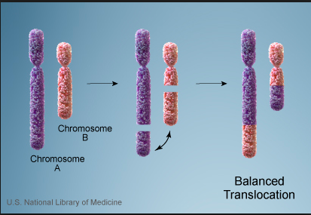
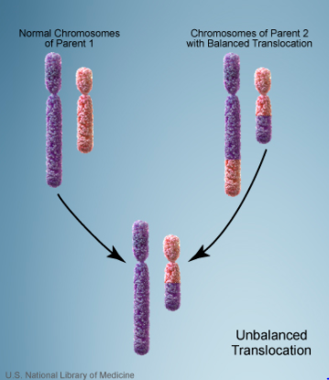
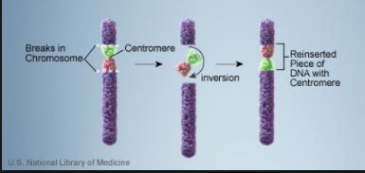
Other chromosomal abnormalities
Rearrangements
Translocations-2 different chromosomes exchange segments
Balanced/reciprocal
No overall gain or loss of genetic material,
however, important genes may be interrupted
Unbalanced
Results in overall loss and/or gain of segments of
genetic material ->often serious negative effects
Inversion-rearrangement “with a twist” within same chromosome 180°
No overall change in amount of genetic material
Can be harmful if critical gene is interrupted.
Notes:
Not only can there be extra or missing chromosomal material which can cause problems, but we can also have rearrangements which can interrupt important genes. We can have translocations, which is when 2 different chromosomes exchange segments with each other. The come in two different flavors. Balanced translocations result in no overall gain or loss of genetic material, however important genes can be disrupted. It is possible for a person with a balanced translocation to have no deleterious effects, however, there may be a danger of producing offspring which will have an unbalanced genome as a result of the parents translocaion. Unbalanced translocation results in an overall gain or loss of segments of genetic material often with serious negative effects. Another type of rearrangement is an inversion. Here there is no overall loss or gain of genetic material, but again can be harmful if a critical gene is interrupted.

Slide 16
HOW DO WE DETECT CHROMOSOMAL CHANGES?
Karyotyping
Organizational map of your chromosomes
Normal human=46
44 autosomes (23 pairs)
2 sex chromosomes (1 pair: XX or XY)
G-banding (Giemsa Stain)
Adenine-Thymine rich regions stain dark
Guanine-Cytosine rich regions stain lighter
Creates a unique banding pattern for each chromosome pair
Detection range: 5Mb and up
(Remember your bases: A,T,G,C ? 5Mb=5,000,000 of those bases)

Slide 17
HOW DO WE DETECT CHROMOSOMAL CHANGES?
FISH
Fluorescence
ssDNA probe with a fluorescent tag which can be seen using a fluorescent microscope.
In Situ
Patient’s cells are “in place” a.k.a. fixed to the slide (patient sample)
Hybridization
Binding process between the patient’s ssDNA which is already affixed to the slide and the ssDNA fluorescent probe which is subsequently applied to that same slide.

Slide 18
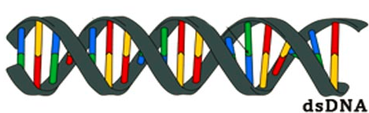
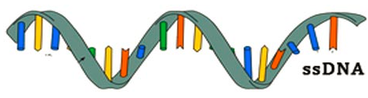
FISH
Once your sample is affixed to the slide (similar to slide making for karyotyping)
Denature your dsDNA (within the chromosomes) ssDNA.

Slide 19
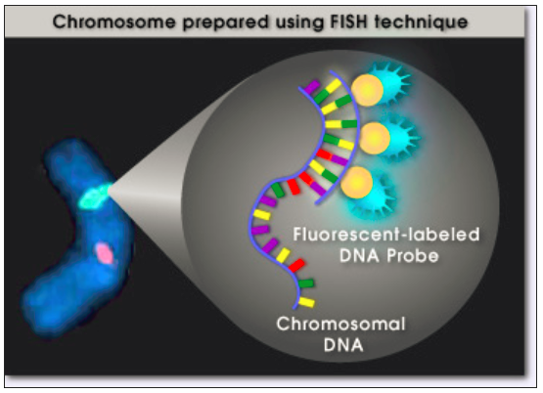
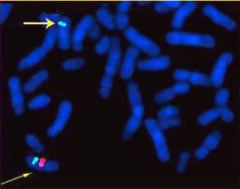
FISH
Apply fluorescently labeled ssDNA probes to the slide.
Remember, these ssDNA probes have a specific sequence and only bind to ssDNA that is complementary to that sequence. If that specific sequence does not exist in the patient sample it won’t bind indicating that the patient has a deletion in that region.

Slide 20
aCGH-ARRAY COMPARATIVE GENOMIC HYBRIDIZATION
Why would I use this instead of karyotyping or FISH?
Covers the entire genome, like karyotyping,
Can detect deletions and duplications as low as 100 Kb, like FISH.
Can give you the EXACT start and stop coordinates for your deletion or duplication, down to the individual base numbers. This means you know the EXACT size of the copy number change (del/dup).
What aCGH can’t do…
Accurately detect rearrangements
Can’t detect balanced rearrangements at all

